Slide 1

Exploration of Metabolic Networks
by Alwine, Nicola and Niko

Slide 2
WP1: Amino Acid Biosynthesis Pathways Extraction

Slide 3
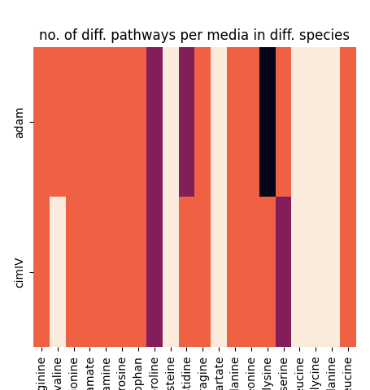
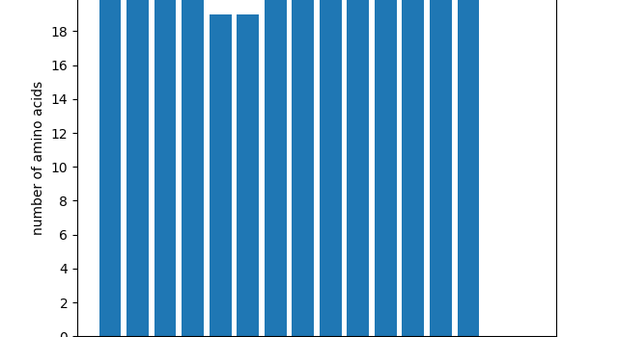
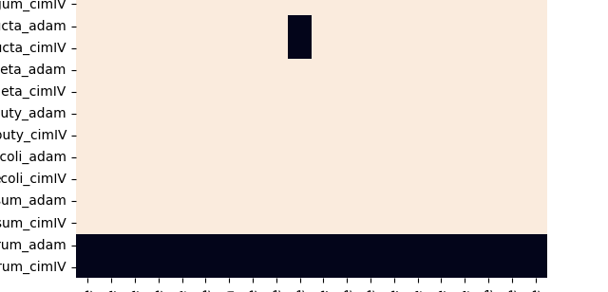
Notes:
used network digraph
hyperedges are represented as separate reaction nodes
reverse reactions are represented by two reaction nodes

Slide 4
WP1: Amino Acid Biosynthesis Pathways Extraction

